Slide 1
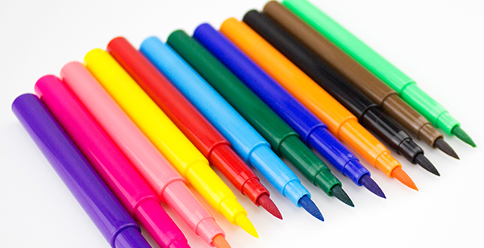
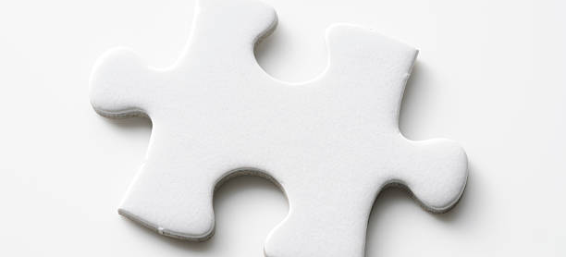
Energizer…
Creativity Puzzle

Slide 2
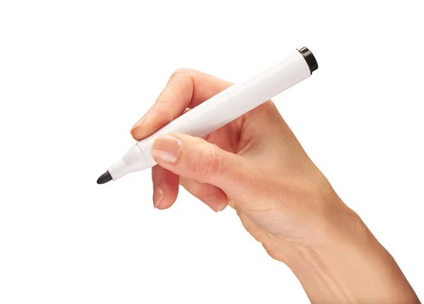

What symbolizes you or your strengths best?

Slide 3
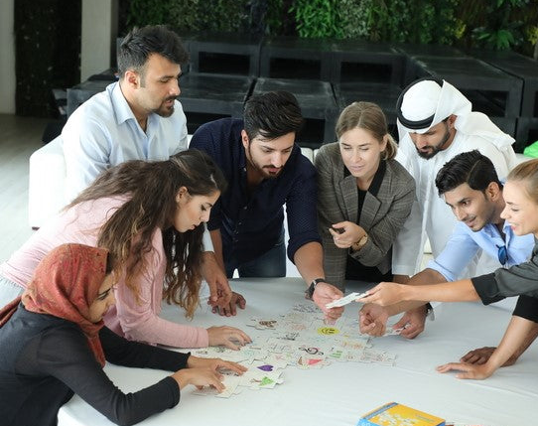
Collaborative Assembly

Slide 4
AATC Collaborative Masterpiece Artwork!
While we celebrate our individuality, our true strength lies in unity. Collaboration is our secret sauce for achieving our common goals.
Embrace Uniqueness, Embrace Unity
Individuality Sparks, Collaboration Ignites
Together, We're the Complete Puzzle
Success Stems from Teamwork
Strength in Diversity, Power in Collaboration
Our differences are our assets. By embracing our individuality, we enhance our collective strength.
When we collaborate, we ignite these sparks into a powerful blaze of innovation.
When we unite our efforts, we create a harmonious whole that achieves more than any of us could alone.
Success isn't a solo act. It's the result of our collective efforts and effective teamwork.
Diversity is our strength, and collaboration is the power that magnifies it.

